Slide 1



DESIGN
THINKING
Let’s start!
Group 10

Slide 2

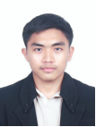

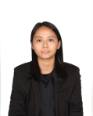

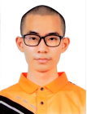

Meet the team
Abdul Wafi
Ammar Yaseer
Manisha
Fadlin Afina
Cheah Zi Feng

Slide 3
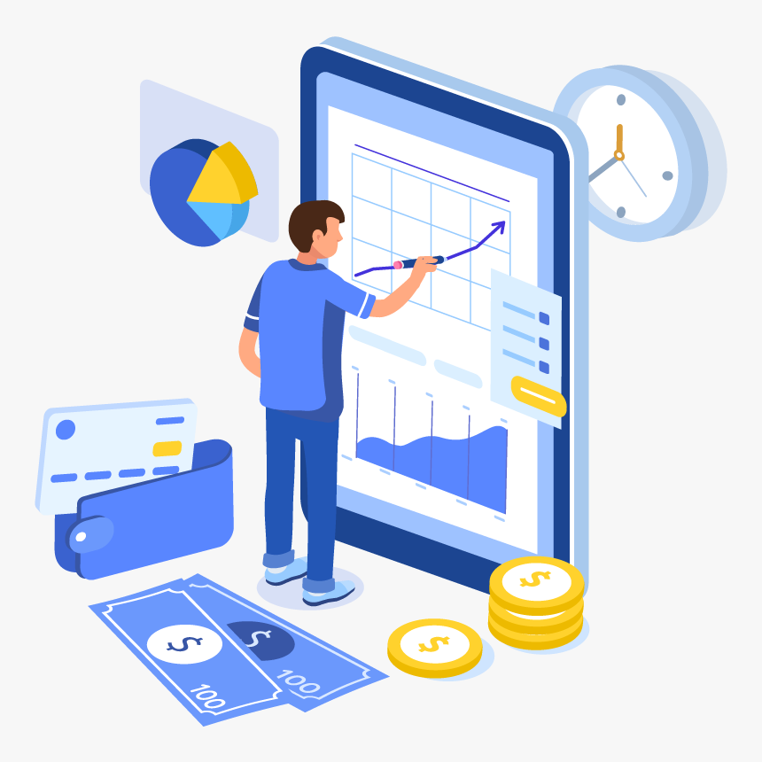

Smart
Money

Slide 4
introduction
Design thinking is a mindset and innovative problem-solving anchored around human-centered. Design thinking can create new things or modify the existing application to fulfill the user’s requirements.
SmartMoney results from a design thinking journey, a powerful tool to be your trustworthy financial partner. SmartMoney is a practical answer to a pervasive issue that plagues students, professionals, and families. SmartMoney is more than just an app; it’s your dependable financial partner. With this powerful tool, you will find managing your money to be less of a headache and more of a hassle-free experience.

Slide 5


steps and description in design thinking
1
4
Emphatize
Prototype
2
5
Define
Test
3
Ideate

Slide 6
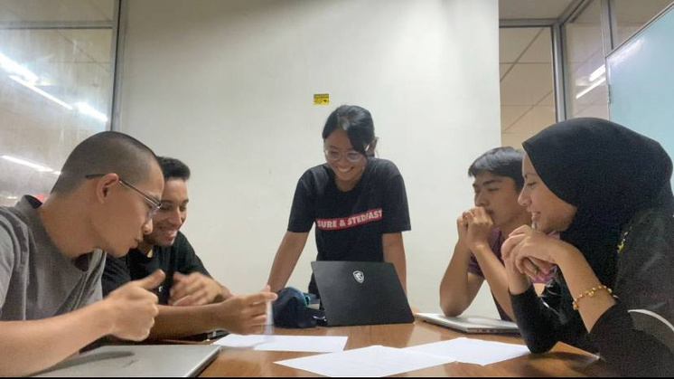
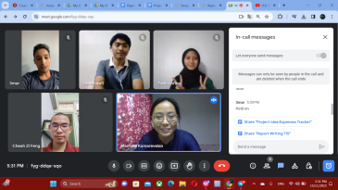
steps and description include problem, solution, team working
Problem statement
Solution
Lack of financial knowledge
Ineffiecient tracking and budgeting
Limited access to suitable tools
A space to share financing knowledge
User-friendly interface
Provide essential function
physical discussion
online meeting

Slide 7

Design thinking assessment points
1
the end of the project demonstration
We assess our solution's effectiveness based on user feedback.
Our team demonstrated effective collaboration during the project.
2
the transition between design thinking phases
Successfully executing detailed plans.
Effective teamwork allowed us to excel in each design thinking phase.

Slide 8
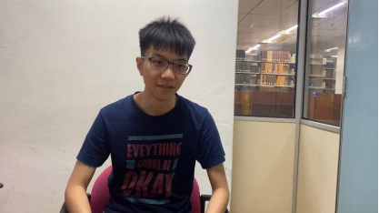
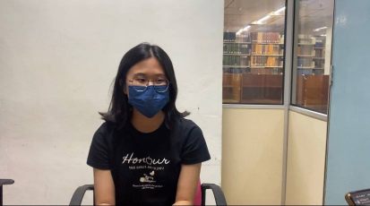
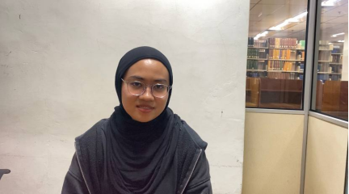
Design Thinking Evidence
Empathize
Q: Do you find maintaining a good habit of tracking and budgeting seemed like a struggle to stay motivated?
A: The short answer would be yes, because life can get pretty hectic, can get busy with classes or with my life. And I do tend to forget other priorities that i have to maintain, other than recording my financial and other stuff.
Q: Have you encountered challenges in understanding effective management in finance strategies?
A: Yes, sometimes I feel like it's very difficult in managing finance and I think I need more guidance and information about it
Q: Have you ever felt that the tools available for managing finances are just too complicated or costly?
A: Yes, I have. For me (the tools) it's too complex and expensive, which doesn't fit my situation. And it led to serious mismanagement in my finances

Slide 9
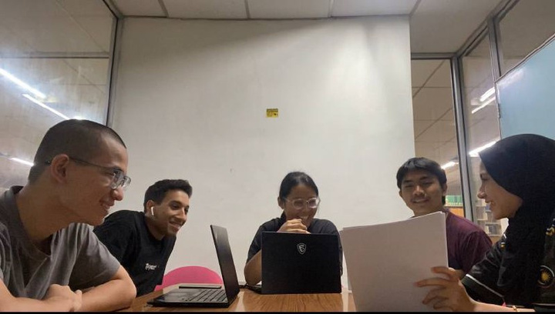
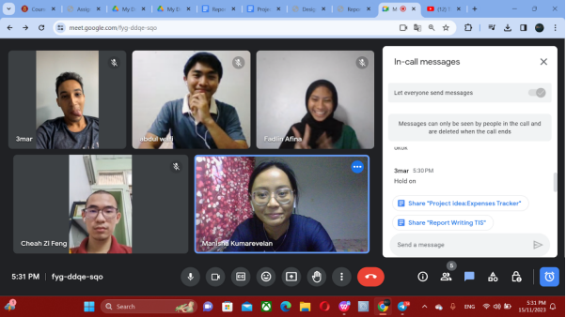
Define
Many users struggle with overspending and accumulating debt due to a lack of budgeting knowledge.
Our solution is to create a community within the Smart Money app where users can share insights and guidance on managing expenses.
Another challenge is users' difficulty in tracking expenses consistently.
To address this, we design the app to appear simple and user-friendly, making expense tracking feel easy and accessible.
Limited access to suitable financial tools is also a problem, often due to complex interfaces and subscription requirements.
The solution is to streamline our Smart Money app, focusing on essential functions and ensuring a straightforward onboarding process for users' basic financial information.

Slide 10
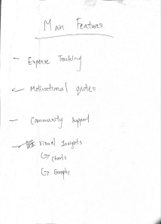
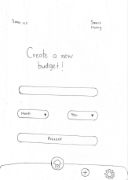
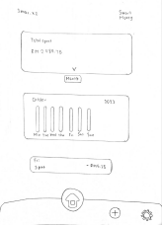
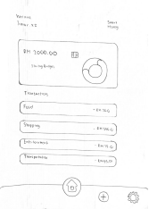
Ideate
We discussed suitable features and improvements that could be made to the app. here is The sketches included appropriate suggestions from the survey and suitable features that are useful for the users. Once we reached an agreement for the sketches, we began to make the prototype on Canva

Slide 11
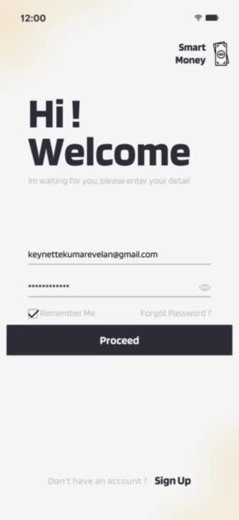
video

Slide 12
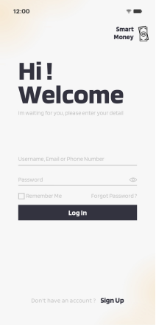
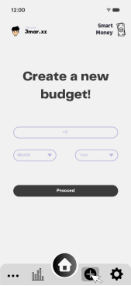
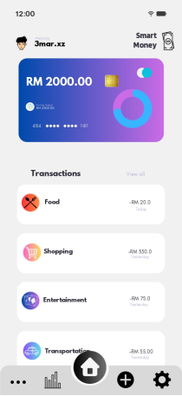
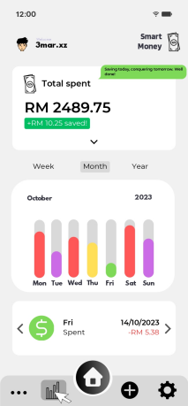
Prototype
We discussed suitable features and improvements that could be made to the app. here is The sketches included appropriate suggestions from the survey and suitable features that are useful for the users. Once we reached an agreement for the sketches, we began to make the prototype on Canva

Slide 13
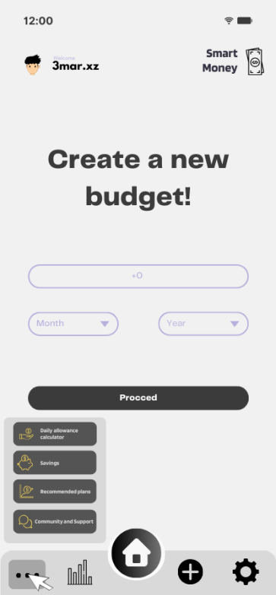
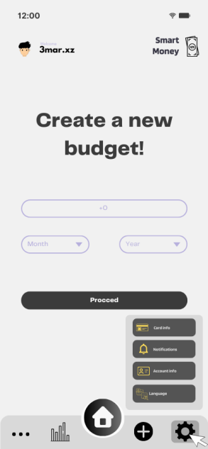
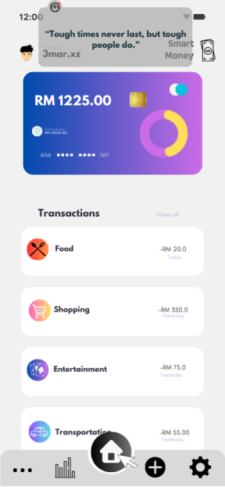
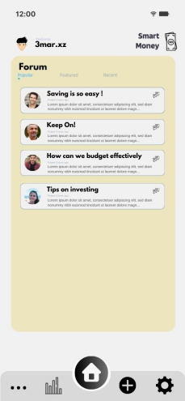
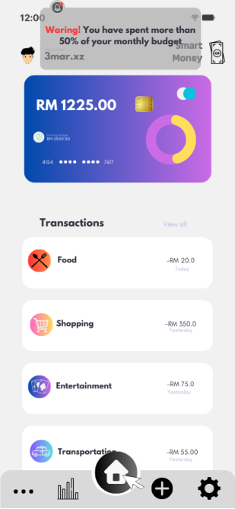
1
3
-Card Info
-Notifications
-Account Info
-Language
5
Daily Allowance Calculator
Saving
Recommended Plans
motivational quotes
2
4
Community and Support
Budget Exceeded Alert

Slide 14
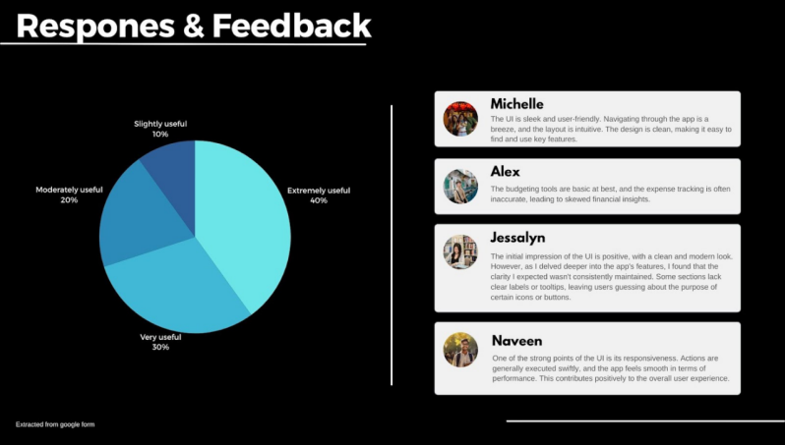
Test
User’s feedback and responces
Some suggestions made by the user
Enhance the expense tracking system to be more efficient and can be further detailed so users can have a better insight into their financial expenses.
More detail labels on every icon so that users can navigate easily in the app
Overall few features and the interface can be improved by giving it more detail

Slide 15
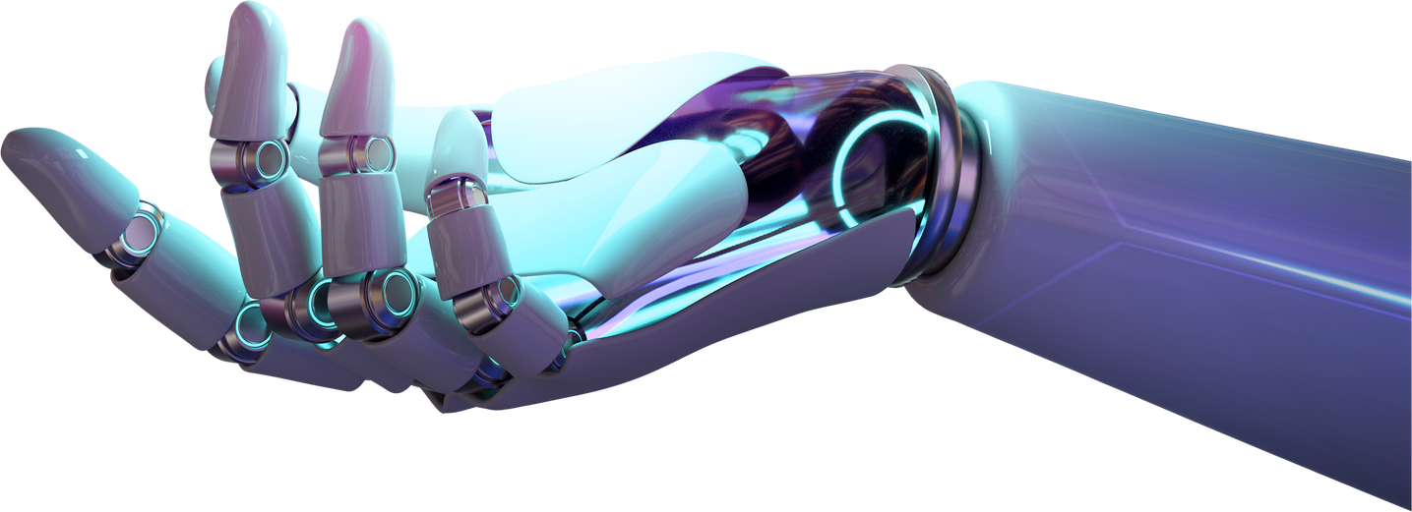
MANISHA A/P KUMAREVELAN
Report writing
Testing phase
Reflection
Detailed descriptions include problem, solution, and team working
Demonstration on testing phase
Task Coordinator
FADLIN AFINA BINTI DAUD
Report writing
Empathize phase
Introduction
Reflection
Planner for interview section
AMMAR YASSER SALAH
Report writing
Prototype phase
Reflection
Prototype designer
Tester
CHEAH ZI FENG
Report writing
Ideate phase
Reflection
Prototype designer
ABDUL WAFI BIN SUHURI
Report writing
Define phase
Design thinking assessment
Reflection
Videographer
Delegation of Task

Slide 16
Thank
you!

